Slide 1
Attention Who
Team Members:
Ahmed Nabih - Ahmed.nabih01@gmail.com
Mohammed Ashraf - g.mohammad.ashraf.99@gmail.com

Slide 2
Agenda
1
Exploring and Visualizing Dataset
2
Dataset Insights Conclusion
3
Feature Engineering
4
Model Experiments

Slide 3
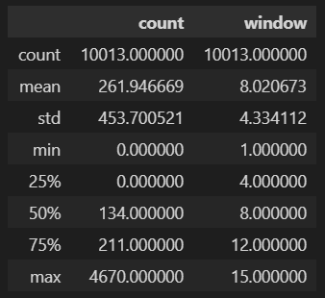
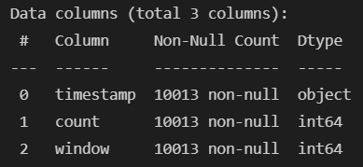
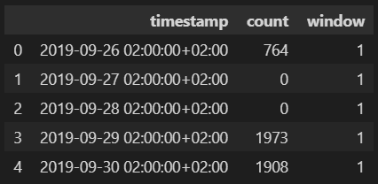
Explore and Visualizing Dataset
2- OH, we need to reformat that timestamp
1- So, we don’t have null values
3- Outliers Alert

Slide 4
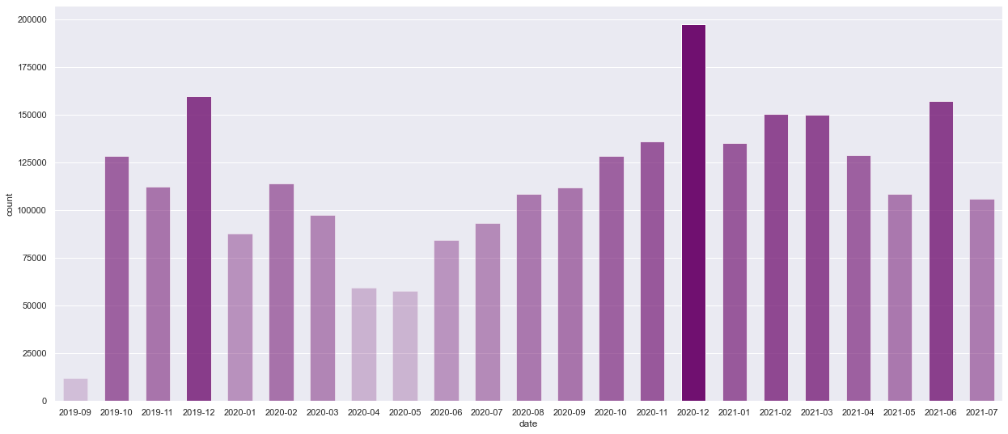
Cont. Explore and Visualizing Dataset
Graph showing relation between month and the total count this month
Count Values took a huge dive here

Slide 5
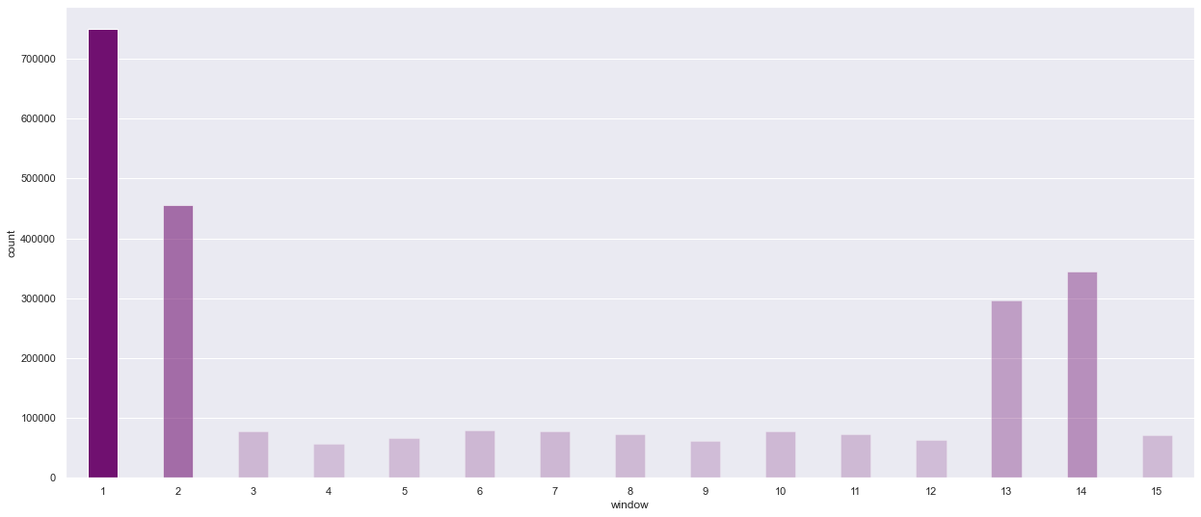
Cont. Explore and Visualizing Dataset
Count per Window through all data month
Windows 1, 2, 13 and 14 appear to have high traffic by nature
Noticeable low traffic windows

Slide 6
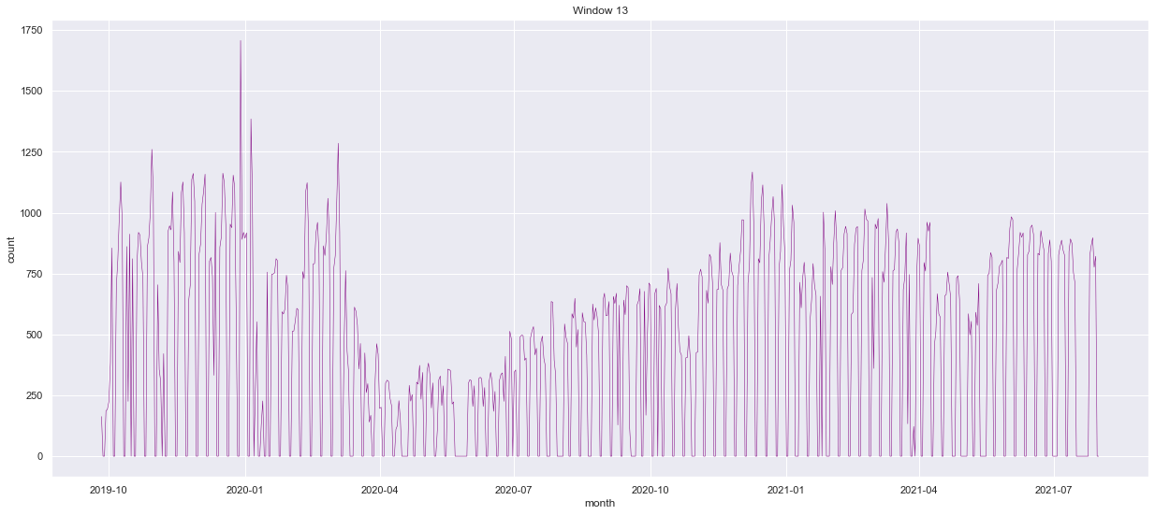
Cont. Explore and Visualizing Dataset

Slide 7
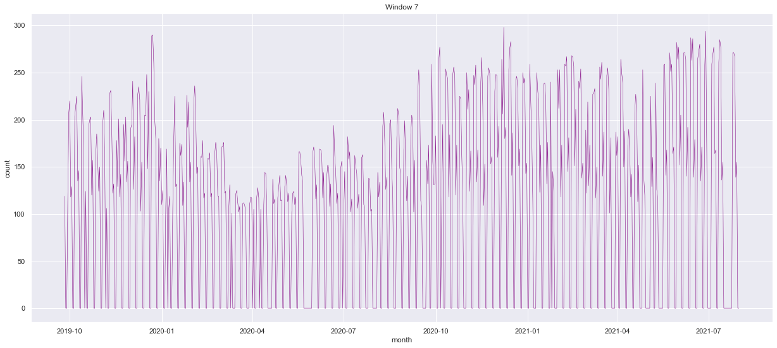
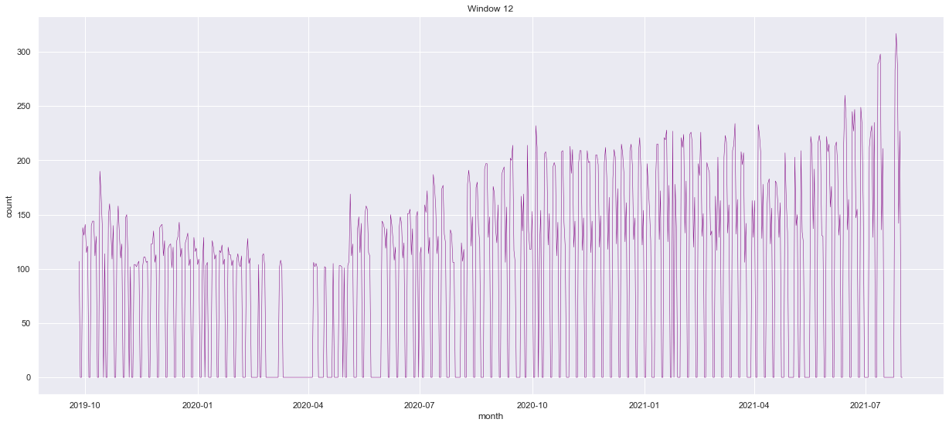
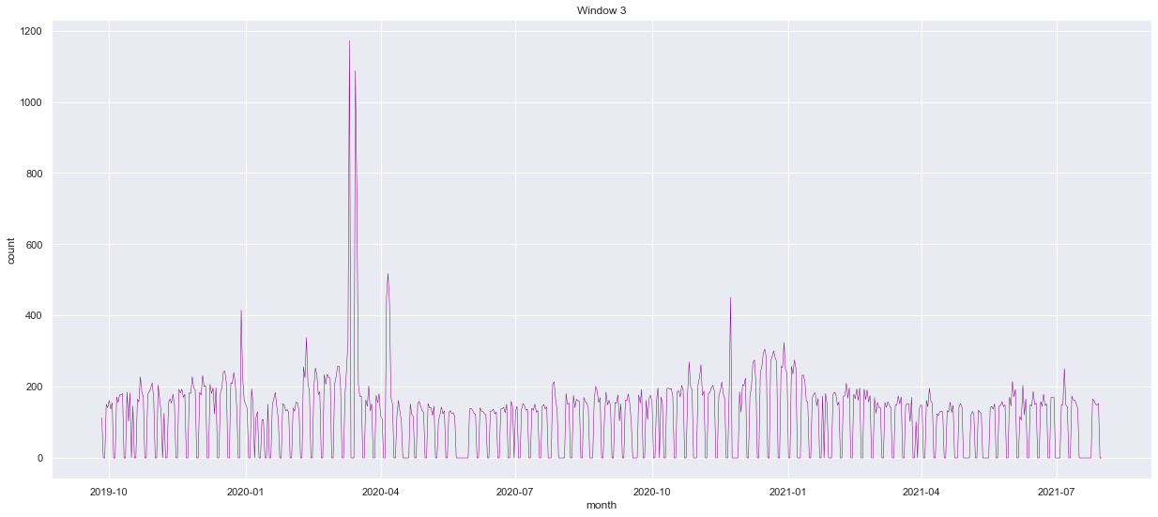
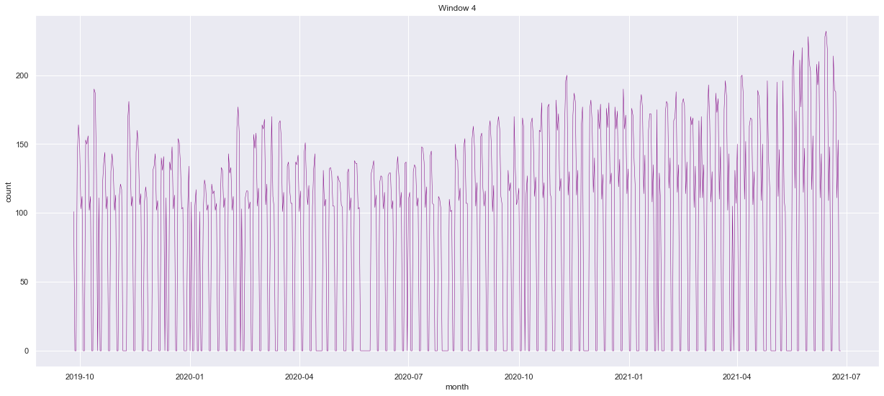
Cont. Explore and Visualizing Dataset

Slide 8
Dataset Insights Conclusion
1
Monthly Counts took a huge dive starting from mid-March 2020 to July 2020
2
Bank windows highly differ in their daily traffic, and thus their counts can behave differently in different situations
3
The dataset contains only 2 features, as we can’t rely on window number and timestamp alone, we should consider adding engineered features
4
This is a real life data, so we should consider what would affect a customer to go to a bank, like holidays or Convid-19 pandemic lockdown that we know it happened during this period

Slide 9
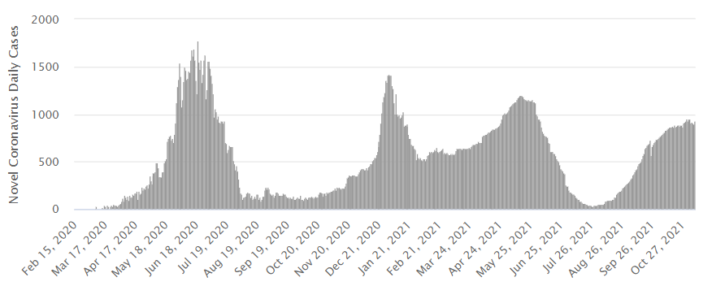
Feature Engineering
We mostly knew that abnormalities starting from mid-March most probably were related to Covid-19 pandemic, so after looking at the daily new active cases, we were sure of that

Slide 10
Feature Engineering
So we decided to get Egypt’s daily active cases and add them as a feature to our dataset (that really improved our model performance but more on that later)

Slide 11
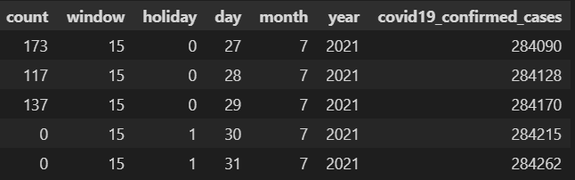
Feature Engineering
We also generated a column stating if this day was a holiday (national holiday or weekend) or a usual working day to explain the zero customers count at windows in these days
We also reformatted the timestamp column to three new feature year, month and day separately to gain more numeric feature for our model
This is our final data frame structure

Slide 12
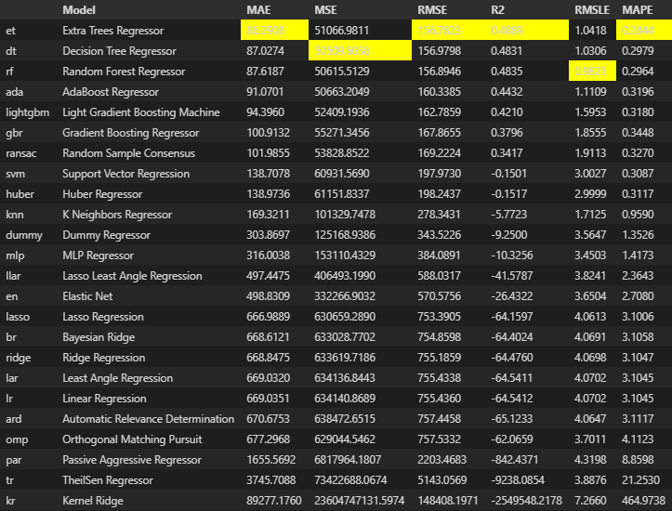
Model Experiments
Usually with this type of regression problems, we should consider various algorithms or models, to get the best one of them.
We tried 17 different approach to minimize the MAE, Random Forest was the best before and after adding feature to data.

Slide 13
Model Experiments
Before the added feature to the data, we were stuck around 80.0 for MAE, after that we reached about 55.8 MAE
Surely all data was normalized in all our experiments, and we took the last month to be our testing set which was predicted by the Random Forest with about 78-80 MAE

Slide 14
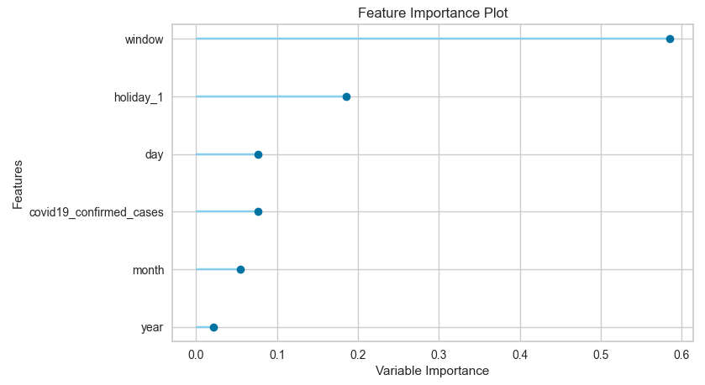
Model Experiments
Insights on important features that mostly activates the model

Slide 15
That’s All, Thank You

